Slide 1


Slide 2

What is it?
A Plug and Play network device
Identify attacks and mitigate
Update automation
Authenticate legitimate users

Slide 3






Our Target Audience
Small Office
Home Office
Small scale businesses
Smart Homes

Slide 4


Research Problem
How to ensure the security of user in an IoT enabled environment ?

Slide 5




Existing Systems
Bitdefender Box
ARCSECURE
Device management
Vulnerability assessment of the devices in the network
Exploit prevention
Brute force protection
Anomaly detection
Advanced parental controls
Network monitoring

Slide 6

Main Objective
Ensure the security of user in an IoT enabled environment

Slide 7



Project Timeline
Stage 02.2
-Website launch
-75% Completion
Stage 02.3
-Launch Beta version
-Bug fixes
Stage 01.1
-30% Completion
Stage 02.4
-Launch Final version
JAN
FEB
MAR
APR
MAY
JUN
JUL
AUG
SEP
OCT
NOV
DEC
Stage 01
-Proposal Presentation
-Submit report
-Kickoff initial work
Stage 02
-Progress presentation 1 and report submission
-50% Completion
Stage 02.1
-Dataset generation
-Training stage
Stage 03
-Final Evaluation and report submission
-100% Completion

Slide 8

Work Breakdown structure
Centralized Hub
Update automation
DoS Detection and P2P Connection
Botnet Prevention
Authentication
IP filtering module
Hybrid IDS
IP filtering learning module
Hybrid IPS
Attack Detection Module
Training Data Module
Mitigation Module
Enable secure communication module
Integrity Checking stage
Hash value storing process
Behavioral Deviation Check
Multi-factor authentication
Account lockout mechanism
User behavioral traits identifier
Port filtering policy
Protocol based
Evolutionary algorithm
ML training phrase
ML classification
Signature Based
Policy Based
ML training
Countermeasure Selection
Check on the device
Check on the site
Pre-update
Post update
Device access authorization
Bio-metric based
Credential based
ARCSECURE

Slide 9

Research Problem
Member 3 – H.N Jayawardhane
How to mitigate system vulnerabilities by optimizing the utilization of system resources while preserving system stability?

Slide 10


Automation and Optimization of Security Updates.
Automation and optimization of security updates by downloading and installing the new/pending updates.
Update Verification mechanism
Update Rollback mechanism

Slide 11
Update Automation and Optimization – Methodology and System Diagram
Hub
IoT Devices
A
Check update file on the device
Integrity checker
Check update file on the original site
IoT device 1
IoT device 2
Store hash value pre-update on the block
Same as site’s
Different than site’s
IoT device 3
Enable auto - download and Install
Check difference and determine update status
Delete corrupted file
IPS/IDS
Store hash value post-update on the block
Rollback to pre-update version
Internet
Check for deviation from normal behavior

Slide 12

Research Problem
Member 1 – A.M Isuru Srimal Abeykoon
How to mitigate botnet attacks

Slide 13
To ensure that IoT devices are not exploited as zombies.
Only activate UPnP on routers when its necessary.
Monitor, gain unauthorized control over IoT devices using IP ports.
Traffic monitoring on port 48101.

Slide 14
Host-Based IPS for botnet attacks – Methodology & System Diagram
Monitoring incoming &
leaving traffic
Secure IP ports
Malicious behavior detection
Password Vulnerability
Privacy Analysis
Port filtering policy
Connection establishment
Protocol Based
IDS
Evolutionary algorithm
Incoming Packets
Success
Success
Success
Anomaly Detection
IP filtering module
Hybrid IDS
IoT Network Monitor
Half open connection
Updates
Malicious behavior
detect
Updates
Anomaly detect
Detect Half open ports
ML training phase
Update port filtering policy
Anomaly-based Method
Stateful protocol analysis
Update Protocol
&
Algorithm
Testing dataset
ML classification model
Testing dataset
ML classification model
IP filtering learning module
Host-based IPS
Drop connection
Drop packet

Slide 15
Research Problem
Member 2 – A.M.S.P.B Atapattu
How to detect and prevent from DoS/DDoS attacks?
How to establish secure communication over IoT devices?

Slide 16

To ensure IoT DoS and DDoS attack detection, mitigation and establish secure connection
Create a way to simulate DoS attack and gather data and develop machine learning algorithm and train it using gathered information to identify DoS attack and create a way to mitigate
Use blockchain technology to support the creation of secure P2P network where all IoT devices would interconnect in a reliable way

Slide 17

Methodology
Machine learning based framework for DDoS attack detection and mitigation
Attack Detection
In this stage all incoming packets are scanned and checked for any malicious content
Training Data
If any data packet is attack suspected will be forwarded to here to train the machine learning algorithm
1. Arriving Packets
2. Attack detection module
3. Training data module
5. Forward or Drop
4. Update Rules
Establish secure P2P network over IoT device while avoiding DDoS threats
Use blockchain technology to support the creation of this secure network

Slide 18
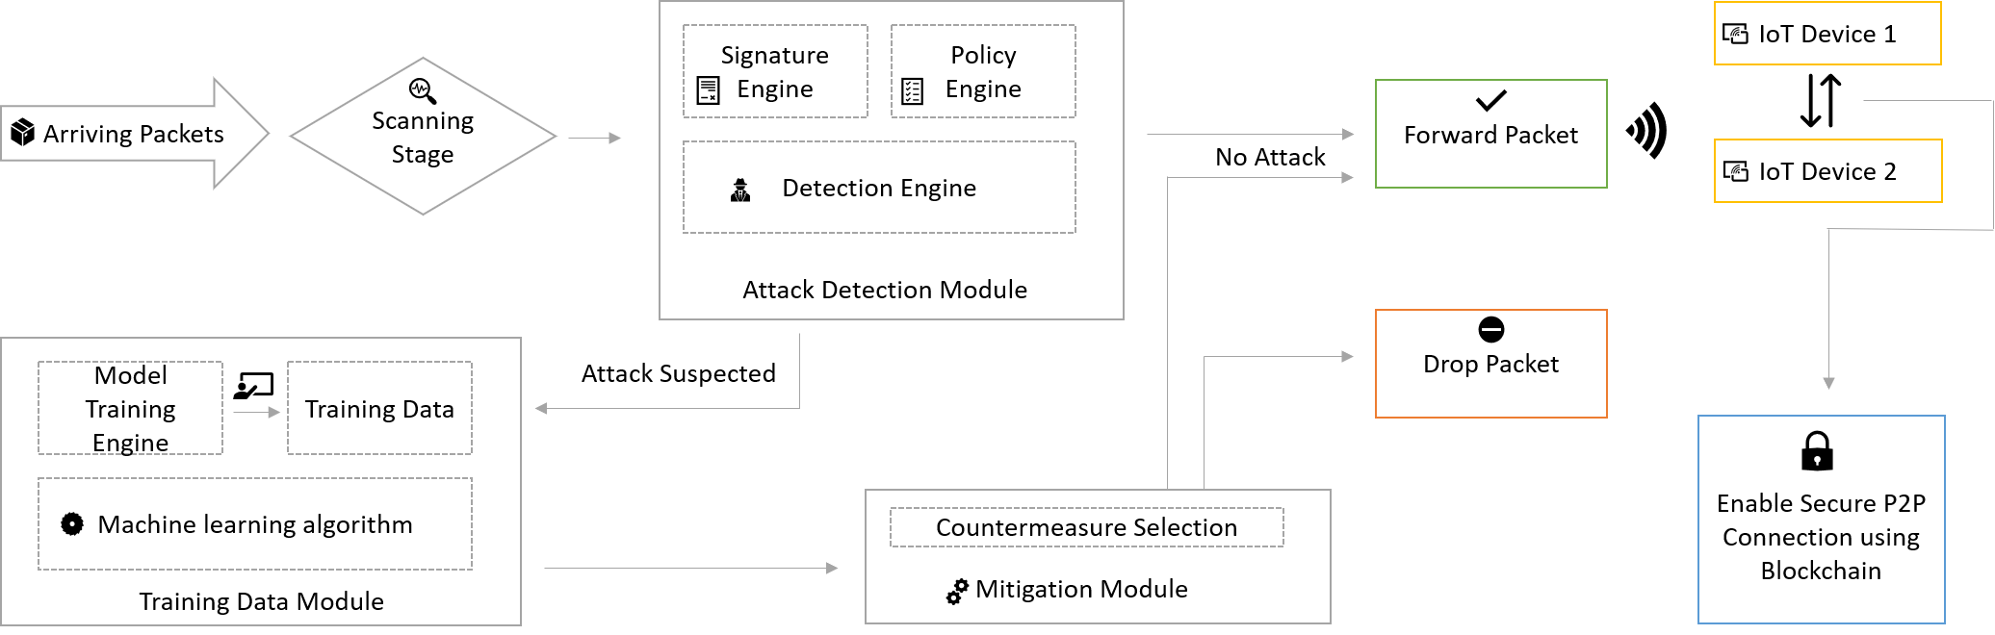
DoS attack detection and Secure Communication– System Diagram
Update

Slide 19
Research Problem
Member 4 – C.N Samarasekara
How can a user securely access IoT devices?
How can a user be granted their respective rights to access the network?

Slide 20
To ensure secure User Authentication & Authorization
Create an SSO feature that can provide access to all devices on the network from just a single authentication process.
Create a more flexible and user-friendly access control feature.
Create a mechanism to identify possible malicious user behavior.

Slide 21

Methodology
Use multi factor authentication together with biometrics to create a secure authentication mechanism.
Create a mobile application with a biometric fingerprint scanner to access the app.
Have the mobile application pop a simple yes/no to validate the user upon signing in.
Implement an access control feature that governs the authority of a user.
Create a machine learning algorithm and train it to identify possible malicious user behavior.

Slide 22








User Authentication & Authorization process with malicious user behavior analysis module – System Diagram
Validate user
Access Captive Portal
No suspicious behavior
Malicious Activity Detection Module
Send a confirmation request
Key logger Engine
Policy Engine
Training Module
Detection Engine
Update
Training Engine
Trained Data
Machine Learning Algorithm
Suspect Activity

Slide 23



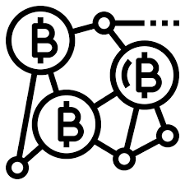
ARCSECURE
Technologies
Machine learning
Blockchain
Languages
Technologies, Languages To be USED
Python
Nodejs
Java Scripts

Slide 24

Business Plan
Potential competitors include Azure, Bosch, Bitdefender Box
Expected Marketing Plan
To provide a limited trial version.
To provide a permanent purchase option
No restriction on the number of devices.
A fee upfront for the device.
A monthly subscription fee.
No termination fee for an in-between termination.

Slide 25
Overall Budget
Raspberry Pi 4 : 15000.00
Domain: 1500.00
Sample devices : 5000.00
Documentation : 1500.00
Total : 23000.00

Slide 26

Thank You
ARCSECURE

